Slide 1

DATA Visualization

Slide 2
DR: SHAHERA RASHWAN
NAME: Nourhan Mohammed Fathy
ID:20221452411

Slide 3
1 - Scraping 2 - load data 3 - pre-processing 4 - Data visualization

Slide 4
1 - Scraping
Web scraping facilitates the extraction of specific information from web pages, turning unstructured HTML content into structured data that can be leveraged for various analytical purposes. like when I extract the data from this page url="https://www.citypopulation.de/en/egypt/cities/"

Slide 5
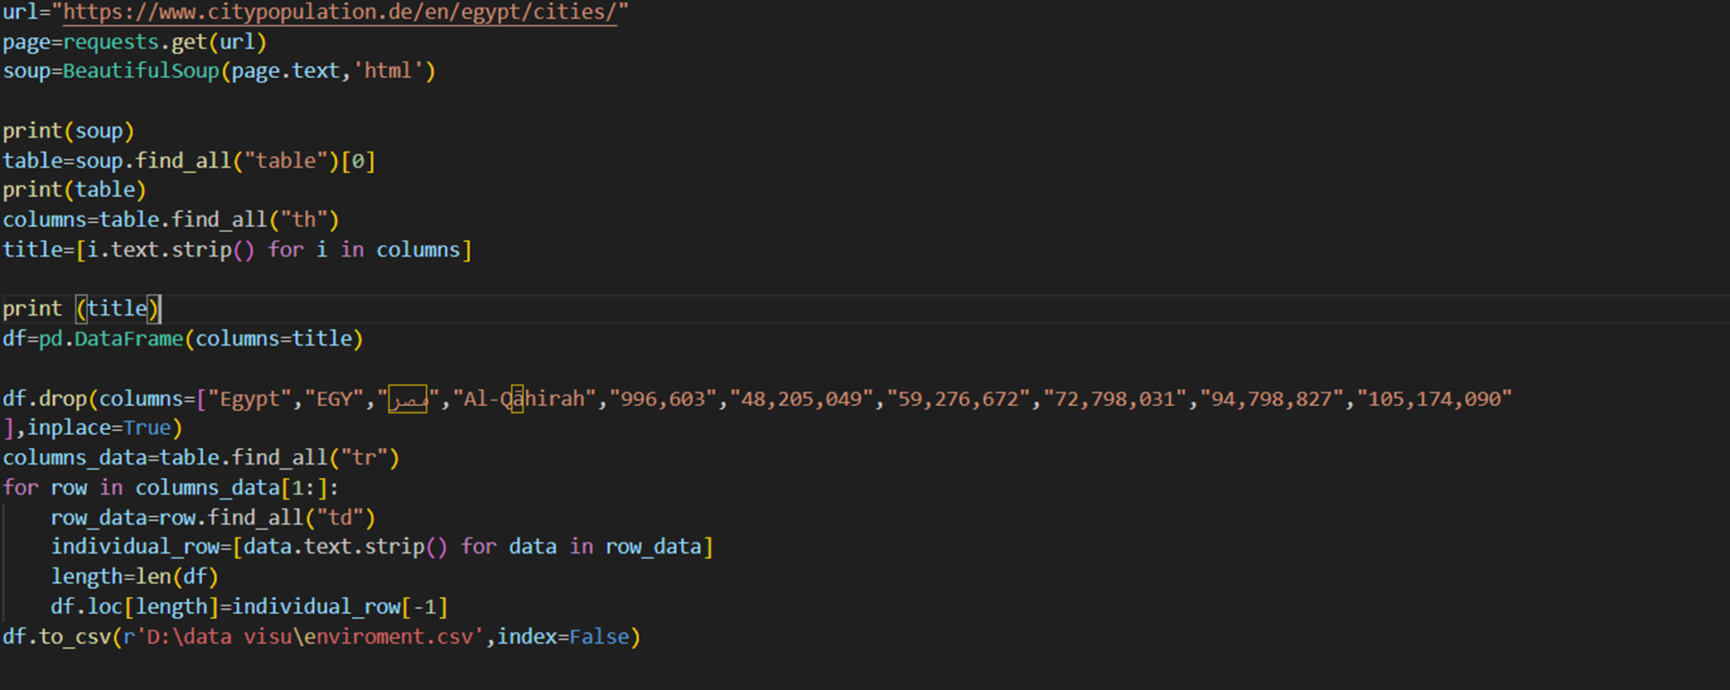
Overcoming nervousness
This code snippet aims to collect and structure city population data from the specified webpage into a pandas DataFrame. However, there are potential issues with the DataFrame creation and data extraction logic, especially concerning dropping unwanted columns and appending row data correctly. Further refinement is needed to ensure accurate data extraction and organization. Additionally, error handling and data cleaning procedures should be implemented for robustness and data integrity.

Slide 6
2 - Load data
this code to load data to csv file ON my pc

Slide 7
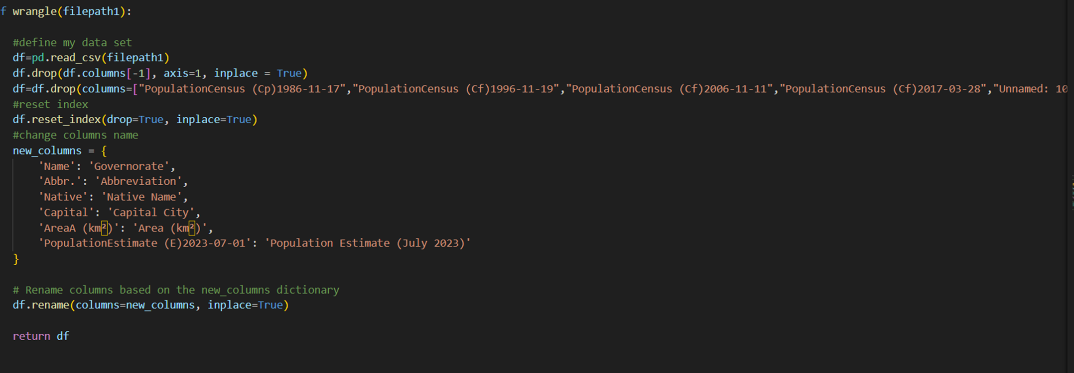
3 preprocessing
drop columns that I didn’t need in my data

Slide 8
3 preprocessing
The wrangle function is designed to read a CSV file containing governorate data, clean it by dropping unnecessary columns, reset the index for consistency, and rename columns to ensure a standardized format. The cleaned DataFrame is then returned for further analysis or processing. This function streamlines the initial data preparation steps, making the dataset more usable and structured for subsequent analytical task

Slide 9
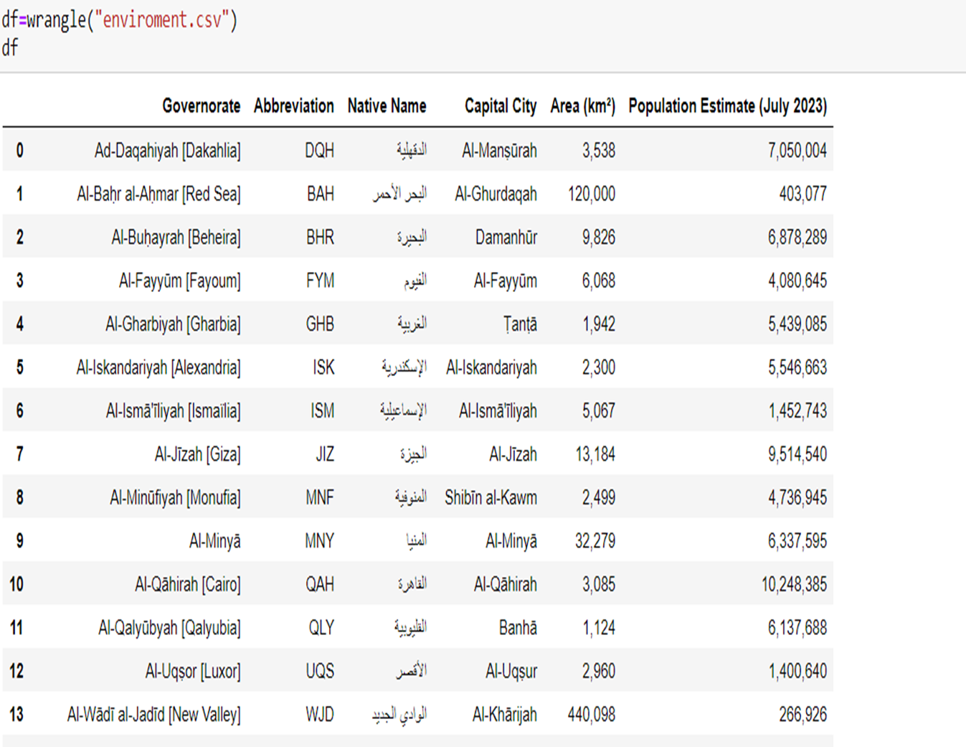
Data after clean it

Slide 10
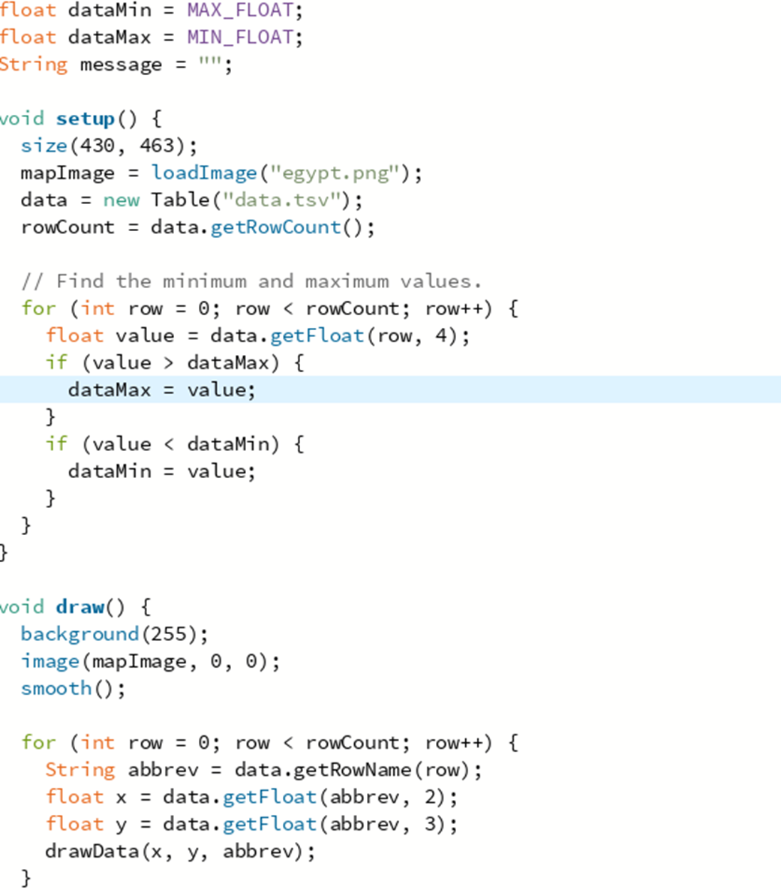
this part is responsible for adding coordinates on the map image with different colors like blue and red based on number of population

Slide 11
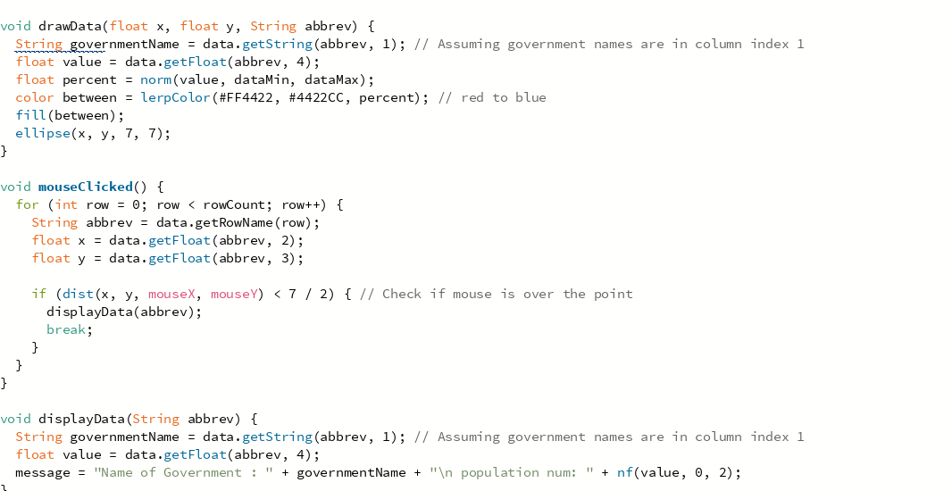
interacting and display the name of gov and area when I clicked on any points

Slide 12
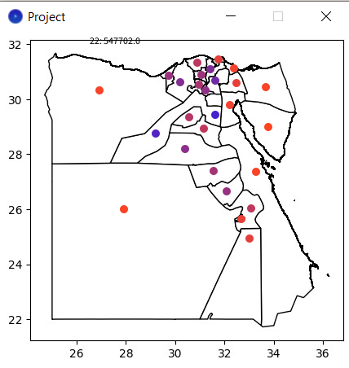
The Result

Slide 13

Thank you

